Slide 1

Note: The data and information in this document is reflective of a hypothetical situation and client. This document is to be used for KPMG Virtual Internship purposes only.
Sprocket Central Pty Ltd
Data analytics approach
[Division Name] - [Engagement Manager], [Senior Consultant], [Junior Consultant]

Slide 2
Note: The data and information in this document is reflective of a hypothetical situation and client. This document is to be used for KPMG Virtual Internship purposes only.
Agenda
Introduction
Data Exploration
Model Development
Interpretation

Slide 3
Note: The data and information in this document is reflective of a hypothetical situation and client. This document is to be used for KPMG Virtual Internship purposes only.
Introduction
Identifying high value customers for business expansion
Definition of the business task
Sprocket Central Pty Ltd specialises in high-quality bikes and accessible cycling accessories to riders.
Their marketing team is looking to boost sales.
We analyzed their existing customer dataset to determine customer trends and behaviour.
Place any supporting images, graphs, data or extra text here.

Slide 4
Note: The data and information in this document is reflective of a hypothetical situation and client. This document is to be used for KPMG Virtual Internship purposes only.
Data Exploration
Data Quality Asessment and Data Cleaning
We found the following issues with
the data and have resolved it:
Sheet Name | Actions
Transactions | Removed blanks in the field online_order, brand, product_line, product_class, standard_price, product_first_sold_date columns
 | Need to change proudct_first_sold_date column to DATE type format
 | Need to change list_price format to CURRENCY from string
NewCustomerList | Remove blanks in last_name,DOB, job_title,
 | Remove n/a values in job industry
CustomerDemographic | Remove blanks in last_name, DOB, job_title, tenure
 | Correct, standardize and rename gender field values from M to Male, F to Female, Remove U values in Gender column
 | Erro in DOB column where date of 1843 exists.
 | Removed Y from the deceased column
 | Remove n/a values in job industry
 | Defaul column makes no sense need to be removed
CustomerAddress | Rename states Victoria and New South Wales to VIC and NSW for standardization

Slide 5
Note: The data and information in this document is reflective of a hypothetical situation and client. This document is to be used for KPMG Virtual Internship purposes only.
Interpretation
Bikes Purchased in Last 3 years By Gender
Data shows that females have purchased more bikes than males.

Slide 6
Note: The data and information in this document is reflective of a hypothetical situatio and client. This document is to be used for KPMG Virtual Internship purposes only.
Interpretation
Bike Purchase by Job Industry
The highest numbers are from Manufacturing, Financial Services and Health industries.
Most of these industries are in the urban and semi-urban areas. People in these areas mostly commute using bikes.

Slide 7
Note: The data and information in this document is reflective of a hypothetical situation and client. This document is to be used for KPMG Virtual Internship purposes only.
Interpretation
No. of Car Owners State-wise
The highest no. of car owners are in new South Wales.
Since all three states have equal amount of people who own and NOT own a car, these could be our markets.

Slide 8
Note: The data and information in this document is reflective of a hypothetical situation and client. This document is to be used for KPMG Virtual Internship purposes only.
Interpretation
Profit from Wealth Segment by Age
The maximum profit is from the Middle Aged (40-49) Mass Customer section.
Across the various age groups, it is the mass customer which registers the highest numbers. They can be targeted.
We can also see a trend of increasing purchasing power up to 49, and then a decline.

Slide 9
Note: The data and information in this document is reflective of a hypothetical situation and client. This document is to be used for KPMG Virtual Internship purposes only.
Model Development
Customer Classification: Targeting Customers
Based on the exploration and analysis, we can target the following customer base:
Females more than males
Working in the Manufacturing, Health and Financial Services sectors.
Age range of 40-49.
People living in all the three states, but Victoria and Queensland should have greater emphasis.

Slide 10
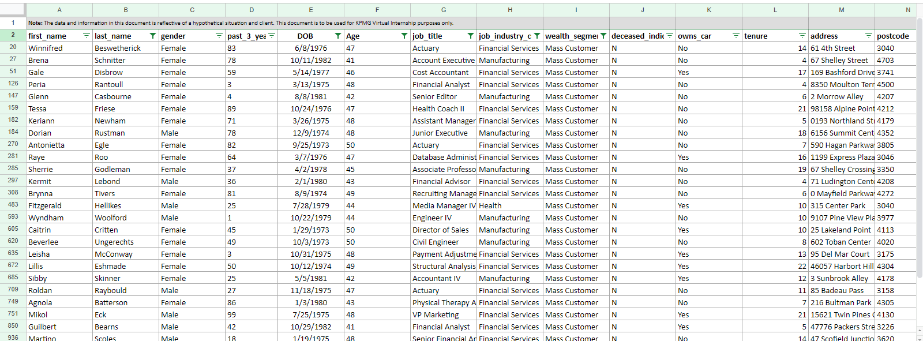
Note: The data and information in this document is reflective of a hypothetical situation and client. This document is to be used for KPMG Virtual Internship purposes only.
Interpretation
A snapshot of customers who can be targeted

Slide 11
Note: The data and information in this document is reflective of a hypothetical situation and client. This document is to be used for KPMG Virtual Internship purposes only.
Thank You!

